Slide 1

Data Overview
Brookwood High School 2015-2016
Intended for Brookwood faculty and staff
Ashley Allgood
KSU -Dr. Sherri Campbell
ITEC 7305 - Spring 2016

Slide 2

Our Story
The purpose of reviewing data is to determine the story of our school. By reviewing the change in data over the years, we can observe trends in demographics and performance, which can guide our instruction, staff development program, and initiatives.
As we review this data, note the performance of our population subgroups. We will discuss our observations at the end of the presentation.

Slide 3
Current Demographic Data by Ethnicity

Slide 4
Population Changes
N.B. the increasing diversity in out student body.

Slide 5
Brookwood 2014 CCRPI
87.9 / 100 + 4.9 Challenge Points =
92.8 Total CCRPI Score

Slide 6
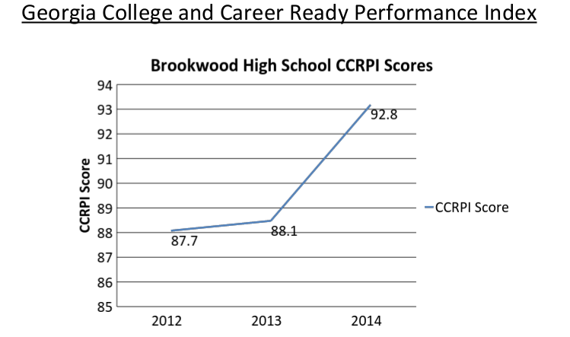
Overview of BHS CCRPI Scores

Slide 7
National Test Scores
SAT
ACT
AP Exams

Slide 8
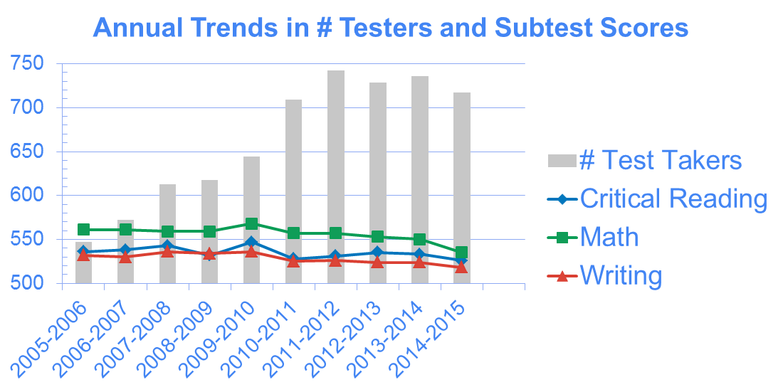
Brookwood SAT Scores

Slide 9
Brookwood SAT
Subgroup Breakdown by Test
Critical Reading
Writing
Math

Slide 10
BHS Total Score Breakdown
Total

Slide 11

Comparison of SAT Scores
Brookwood Rank
within Gwinnett County by Total Score
School, County, State, and National Averages, 2014-2015

Slide 12
Brookwood ACT Score
Yearly Comparison

Slide 13
BHS ACT Score Breakdown
Yearly Comparison of Average Composite Score by Race/Ethnicity

Slide 14
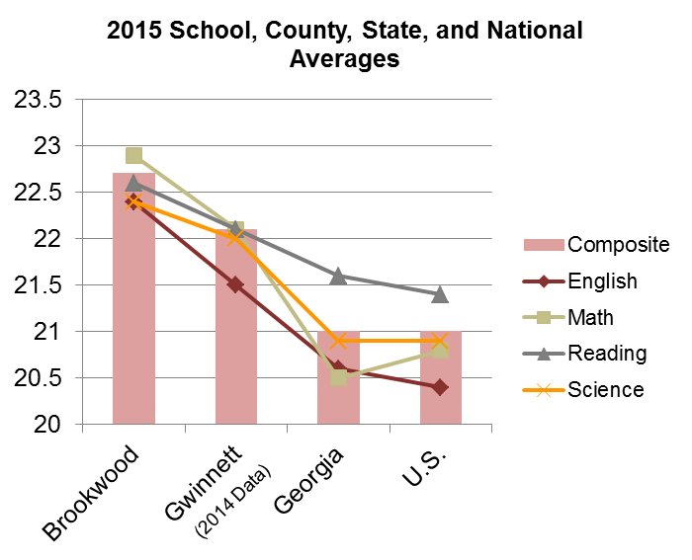
Comparison of Brookwood
ACT Scores
2015 School, County, State, and National Averages
Composite Score

Slide 15
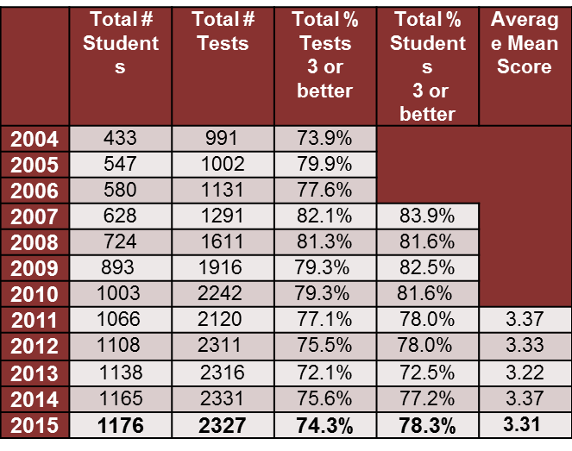
Brookwood AP Test Scores
Yearly Comparison

Slide 16
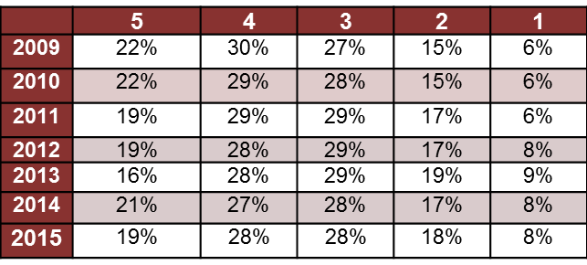
Brookwood AP Score Distribution
% of Total Exams Receiving Each Score Point
# of tests taken – 2,327

Slide 17
Brookwood AP Score Subgroup
Breakdown: Ethnicity
Score Comparison by Ethnicity
 | Total # Tests | Mean Score
Amer Indian/ Alaska Native | 2 | 2
Asian | 720 | 3.35
Black | 375 | 2.96
Mexican or Mex Amer | 65 | 2.66
Puerto Rican | 14 | 3.29
Other Hispanic/Latino | 93 | 3.25
White | 978 | 3.49
Other | 67 | 3.37
No Response | 13 | 2

Slide 18
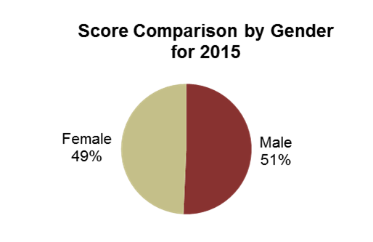
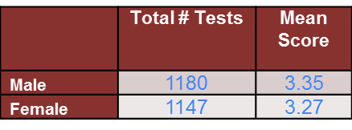
Brookwood AP Score Subgroup
Breakdown: Gender
Score Comparison by Gender

Slide 19
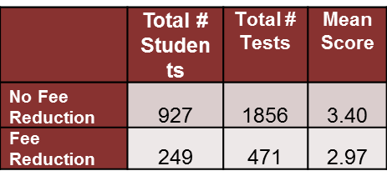
Brookwood AP Score Subgroup
Breakdown: Fee Reduction
Score Comparison by Fee Reduction

Slide 20
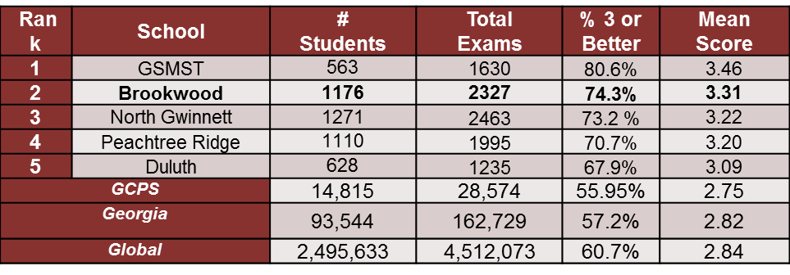
Brookwood Comparison of AP Scores

Slide 21
School Strengths
Ever increasing CCRPI Score
Successful AP program – higher number of participants and higher test scores
Consistent ranking in top 5 scores in district
Constantly scoring above the State averages!

Slide 22
Opportunity for improvement:
Math
Struggles in Math are seen throughout standardized tests, especially in subgroups. This weakness is most obvious in
End of Course Tests
10th grade PSAT scores
2015 SAT Scores

Slide 23
BHS Math EOC Scores
N.B. the changes in the “Does Not Meet” category

Slide 24
BHS 10th Grade PSAT Score
N.B. – the constant decrease in Math Scores
Math Mean Score
Year

Slide 25
BHS SAT Scores for Math
BHS SAT Math Mean Score Over Time
N.B. the changes in the achievement gaps

Slide 26

Data Summary
Even with the ups and downs in the scores, it is obvious that BHS is aiming for excellence. Let’s use this data to spark a discussion into ways to help all of our students achieve higher levels of performance.

Slide 27
Discussions
1) What data surprised you?
2) What are some other opportunities for growth?
3) The population demographics show an ever growing diverse student body. Are our classroom practices supporting diversity? What can we do to foster more culturally diverse practices?
4) How can our cluster work together to close the achievement gaps?

